Slide 1
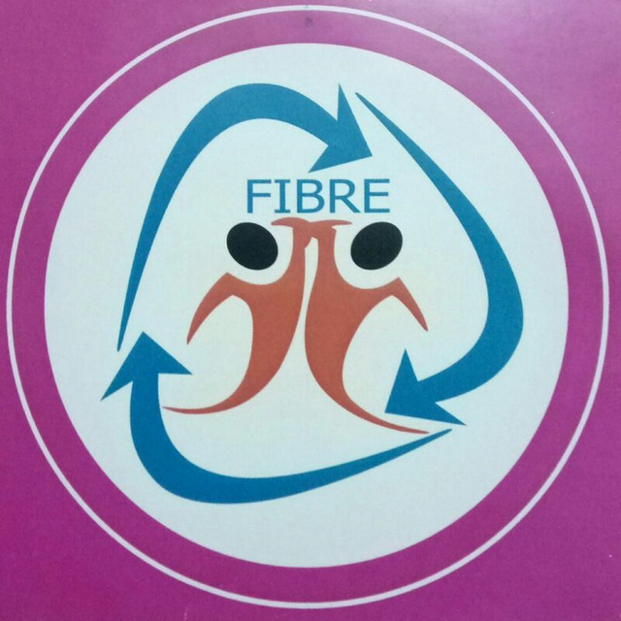
FIBRE EVENTS 2020

Slide 2
04/01/2020 - Family Get-together at VGP Resort
24 (Members) + 20 (Spouses) = 44 Members participated.

Slide 3
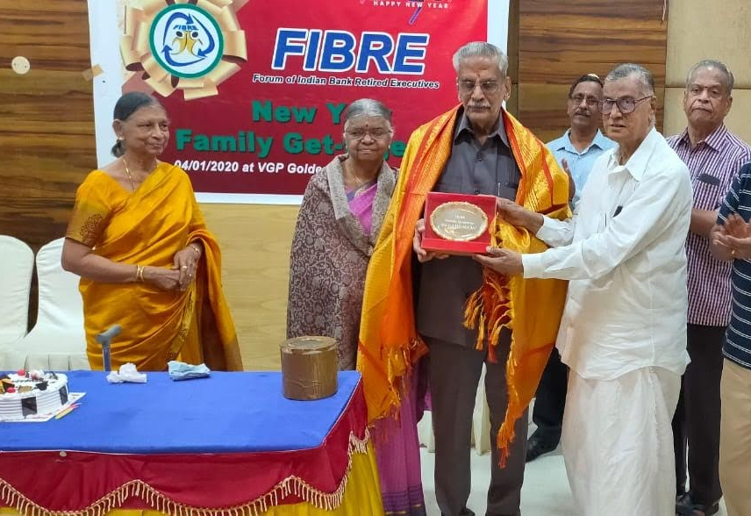
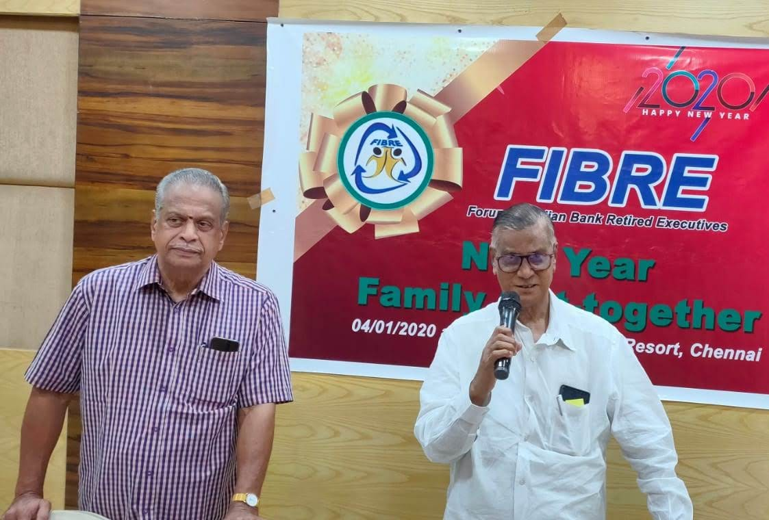
04/01/2020 - Family Get-together at VGP Resort
Mrs/Mr O R Thangaraj, Octogenarian honoured

Slide 4
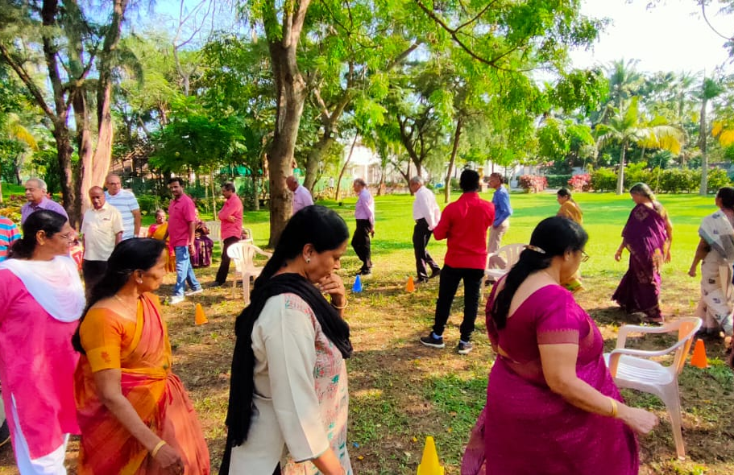
04/01/2020 - Family Get-together at VGP Resort
Indoor/Outdoor games organised
Prize distribution with New year Cake cutting concluded.

Slide 5
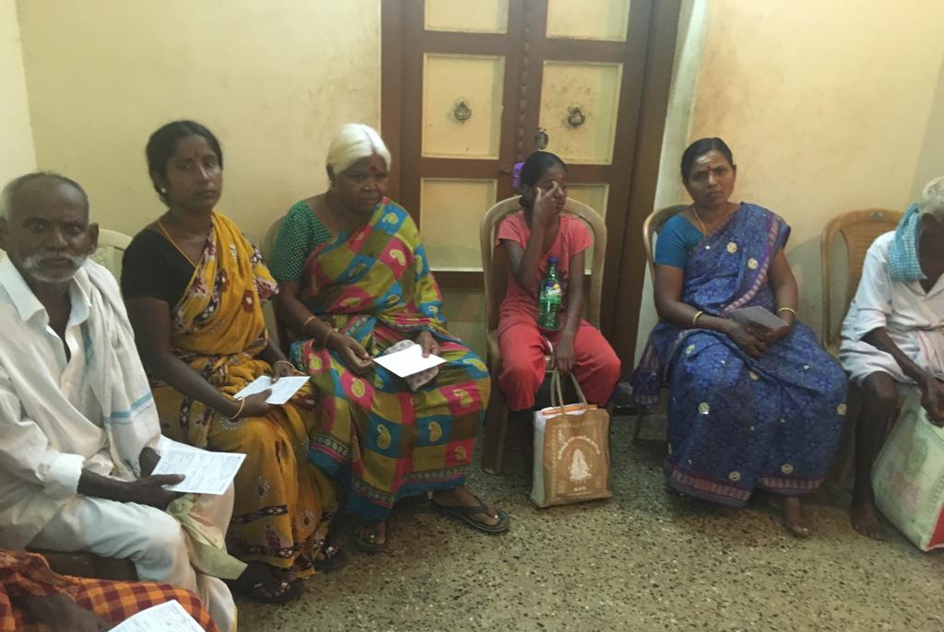
04/01/2020 - FIBRE sponsorship for Social cause – distribution of spectacles for the participants of Free Eye Camp organised on Saturday at Kandavarayanpatti Sivaganga Dist. Coordinated by octogenarian Shri SM Subramanian, DGM Retd /our Life Member.

Slide 6
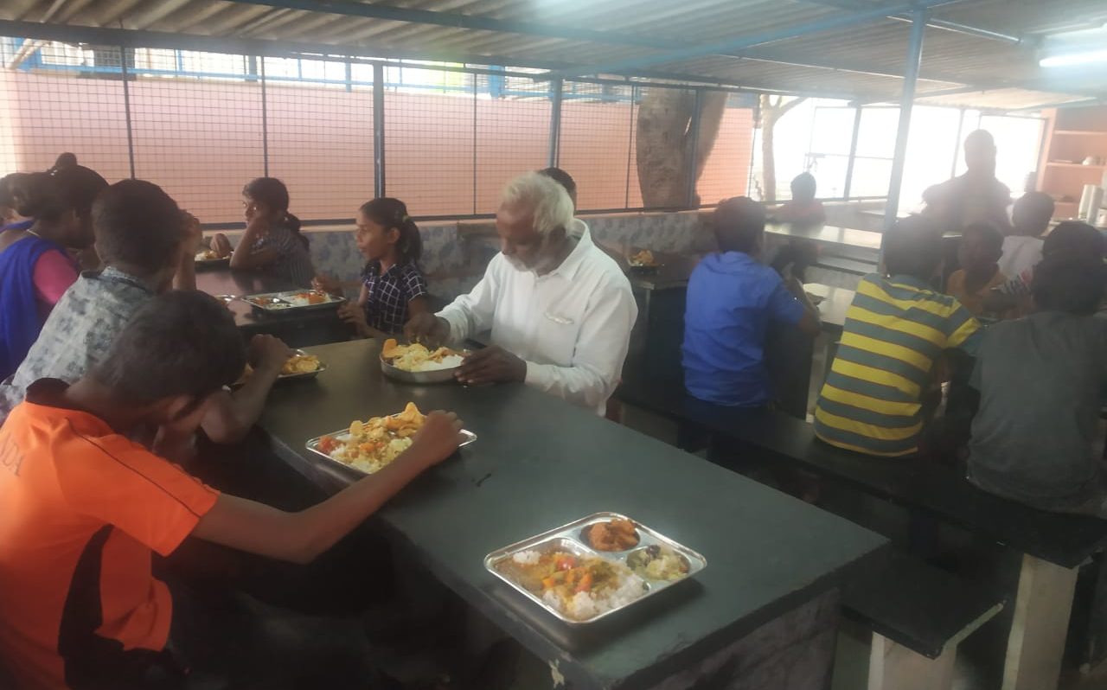
10/05/2020 - FIBRE organised lunch to the 45 inmates of “GIVE THE LIFE Children Home” at Red Hills, Chennai on Sunday 10/05/2020

Slide 7
15 Years of FIBRE
27/06/2020 - Released a Bulletin on activities of FIBRE coinciding 15th year of successful completion – sent by mail to all members.

Slide 8
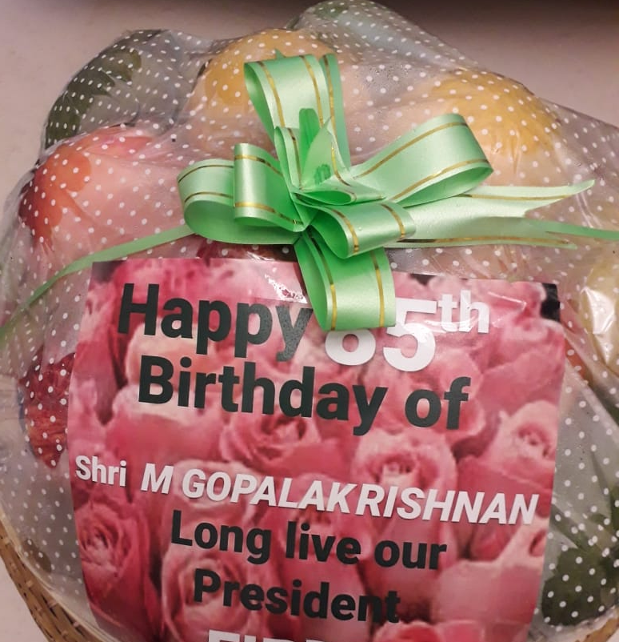
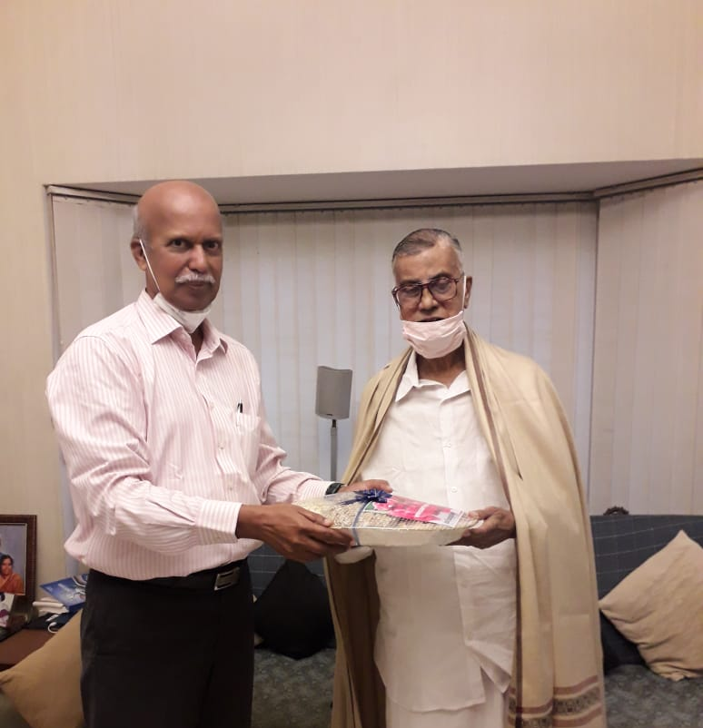
29/07/2020 - Honouring our Founder President on his 85th Birthday at his residence

Slide 9
15/08/2020 - First Trial Zoom Meet conducted in two batches –
Huge success - very good response by members – participation 63 in first batch and 44 in second batch
30/08/2020 - Office bearers virtual meet conducted – Decisions taken
a) One time Life membership fee increased to Rs3000/- (from Rs.2000/-)
b) Enrolling eAB executives as IB retirees after 1.4.2020
c) New eAB enrolled members will be included in FIBRE Whatsapp Group hereafter
d) To strengthen FIBRE activities, necessary new coordinators/ committee members will be inducted from IB and eAB for States/Regional chapters

Slide 10
12/09/2020 - Meeting of Members from Andhra Pradesh and Telangana States convened on Saturday at 4.00 PM via Zoom. 32 Members participated
13/09/2020 - Zoom Meet jointly organised for the members of New Delhi, UP, Haryana, Gujarat, Punjab, Patna, Uttarakhand, Rajasthan, Madhya Pradesh, West Bengal, Odisha and Maharashtra

Slide 11
11/10/2020 - Online Zoom Meet of Office Bearers & select Executive Committee Members from different States held at 4 pm.
Resolved to condole the sad demise of
Founder President Mr M Gopalakrishnan on 30/09/2020
Life Member Mr R Manimaran, GM Retd on 17/09/2020
Life Member Mr VE RM Vayiravan, AGM Retd on 02/10/2020
Resolved to Elect Mr T Jothipandian for the Post of President (in view of demise of Founder President Mr M Gopalakrishnan)

Slide 12
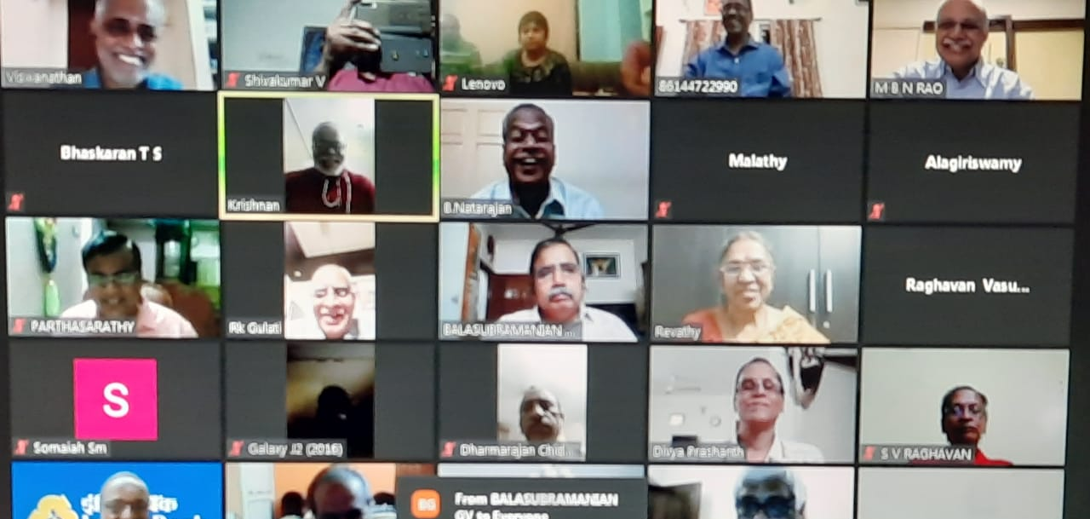
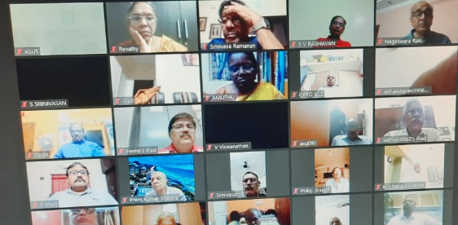
22/11/2020 - Zoom Meeting to pay homage to Mr M Gopalakrishnan, Former CMD, Indian Bank and Founder President, (passed away on September 30,2020) on Sunday, 4 pm with the participation of former Officers' / Workmen Directors and Principal Office Bearers of Unions / Officers' Association / Retirees' Associations who were associated with him while serving the bank.

Slide 13
FIBRE – INDBANK MEETING HELD ON 23/12/2020

Slide 14
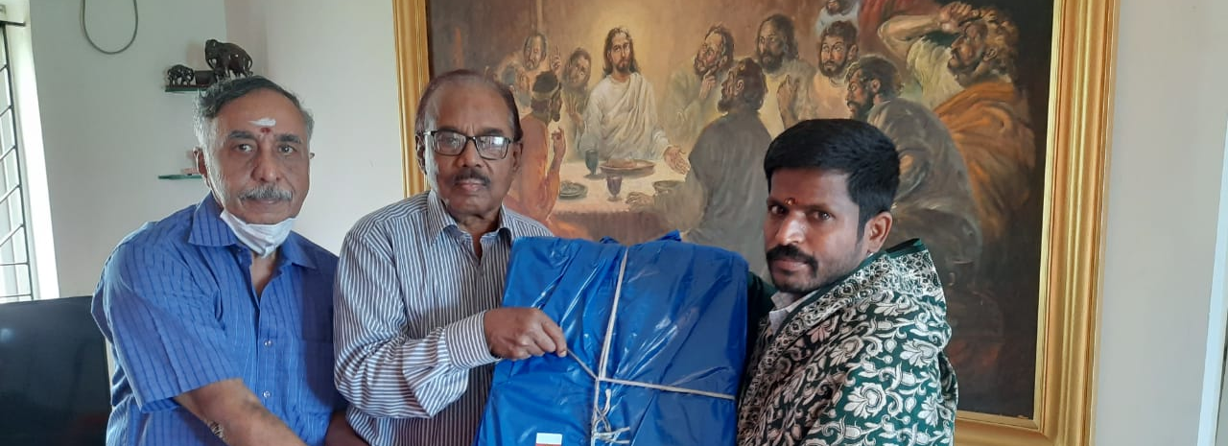
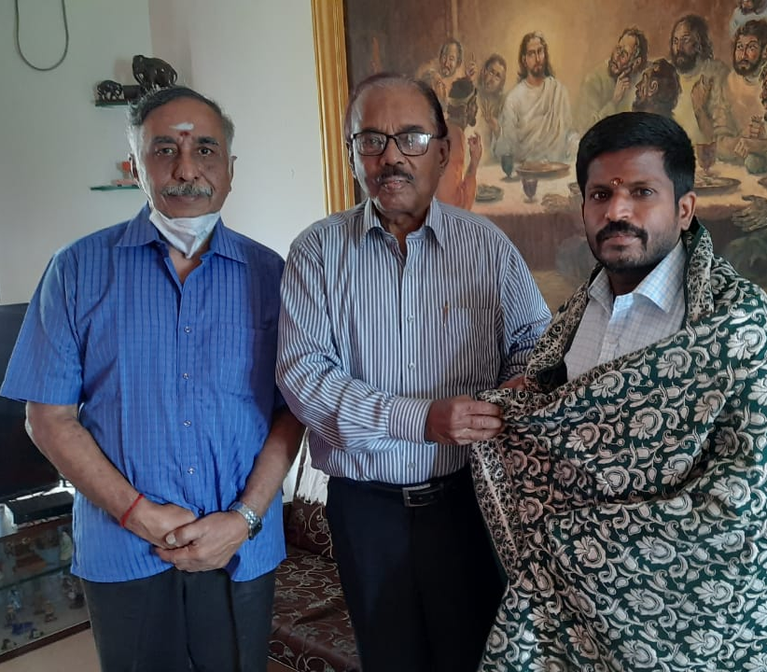
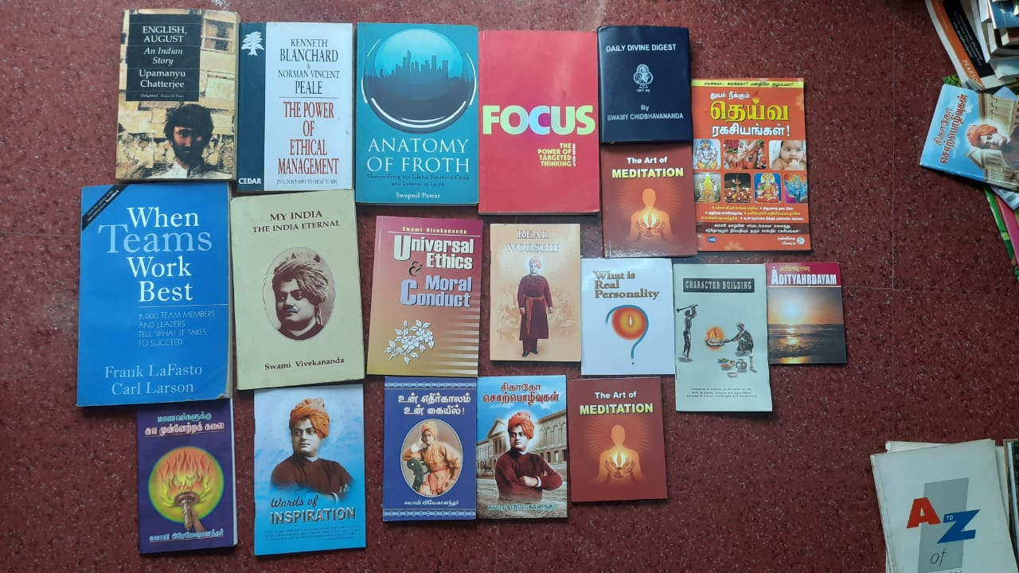
27/11/2020 - At Chennai, On behalf of FIBRE, our President Shri JOTHIPANDIAN donated 60 books on various topics to the SALOON LIBRARY maintained by Shri PON MARIAPPAN of TUTICORIN- 628008 (Tamil Nadu). Incidentally, Shri PON MARIAPPAN was recognized and honoured by our Prime Minister during the program MANN KI BAAT with the Nation on 25 Oct2020.

Slide 15
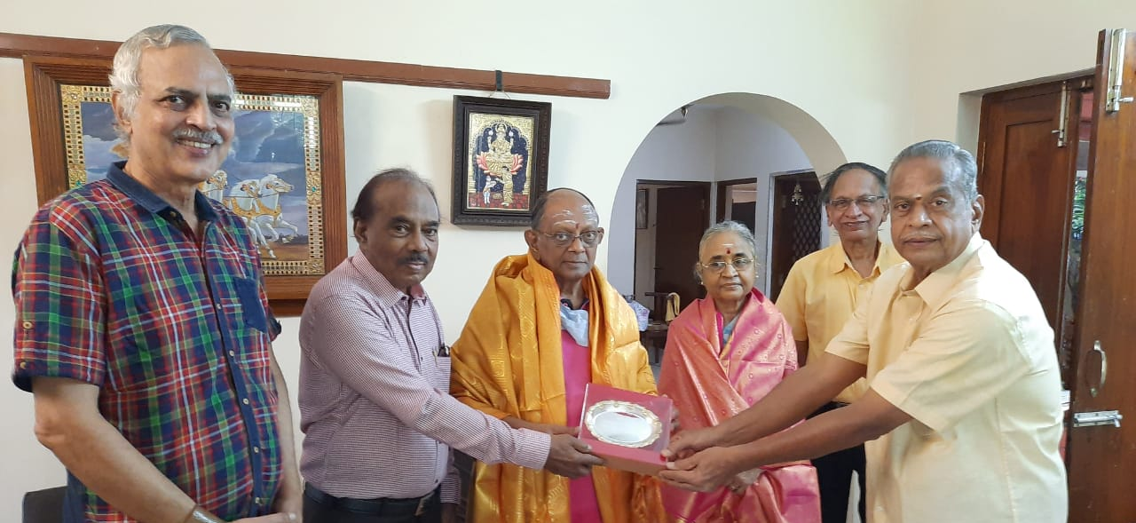
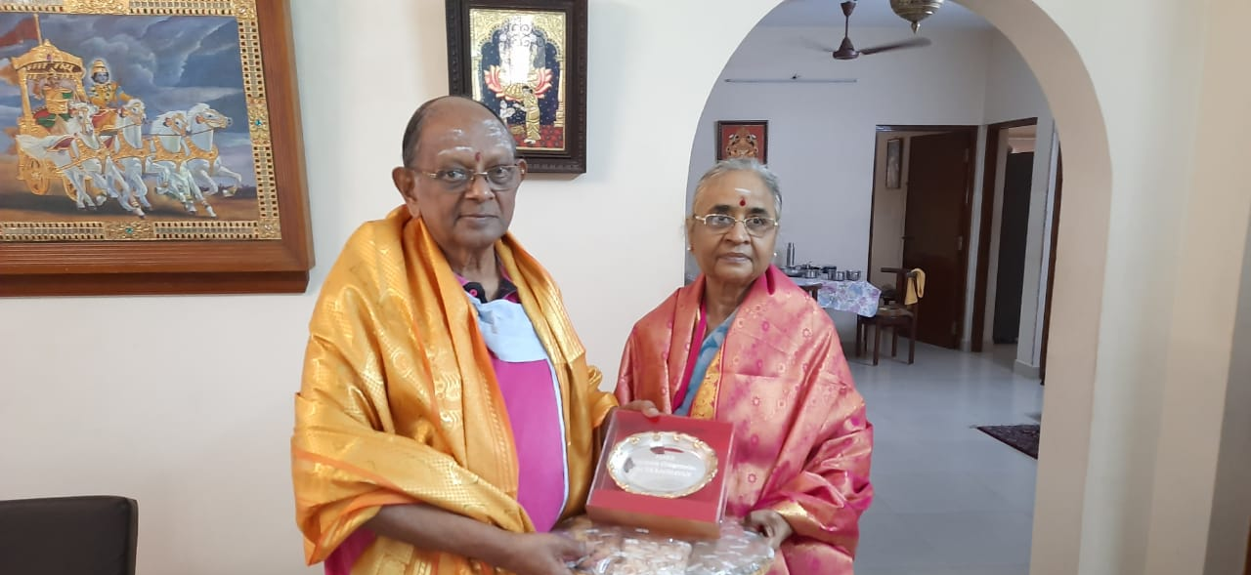
29/11/2020 - 11.00 am FIBRE Honoured Octogenarian Shri T S RAGHAVAN Former CMD (30/04/1940) and Life member at his residence Chennai

Slide 16
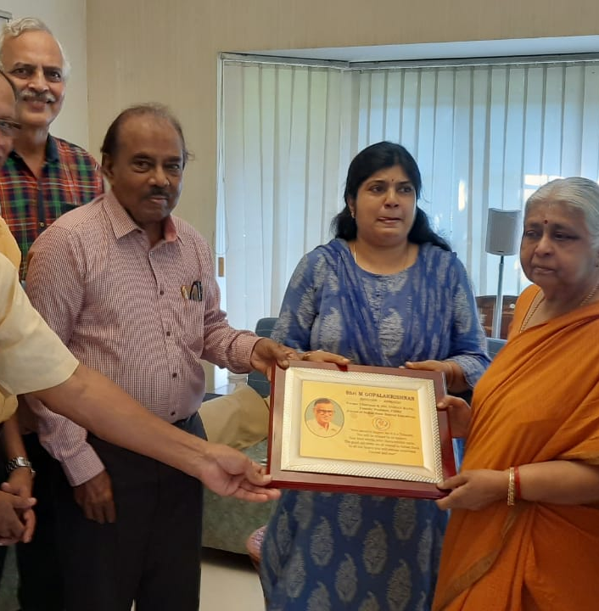
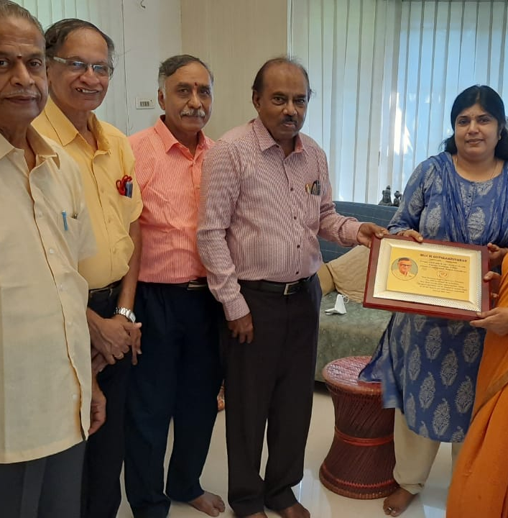
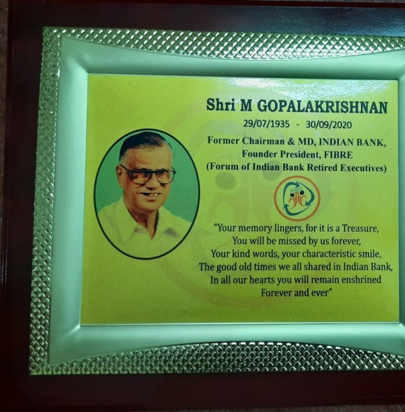
29/11/2020 - 12.00 Noon FIBRE presented a PLAQUE to the family members of Founder President late M GOPALAKRISHNAN at their residence, recollecting the memories of our association with him.

Slide 17
Members’ Directory – Oct 2020
29/11/2020 - 5.00 pm - FIBRE Governing Body Virtual meeting conducted -Third edition of FIBRE directory as of October 2020 with 523 Life Members released during the meeting by our President Shri T.Jothipandian

Slide 18
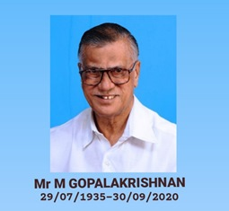
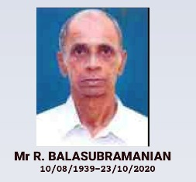
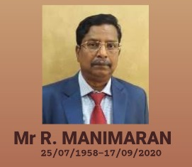
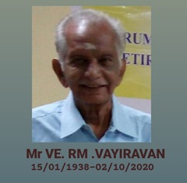
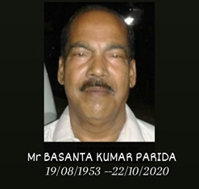
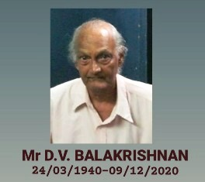
Respectful Homage to our Members who departed from us during 2020

Slide 19
Happy New Year 2020

